Slide 1


Plug-in Architecture
itechart.com
2020

Slide 2

Contact
Maksim Hladki
Software engineer
Department: D6 G2
Contact information:
Email: maksim.hladki@itechart-group.com
itechart.com

Slide 3

Introduction
The plug-in architecture (sometimes referred to as the microkernel architecture) is a natural pattern for implementing product-based applications. A product-based application is one that is packaged and made available for download in versions as a typical third-party product. The plugin architecture allows you to add additional application features as plug-ins to the core application, providing extensibility as well as feature separation and isolation.
itechart.com

Slide 4
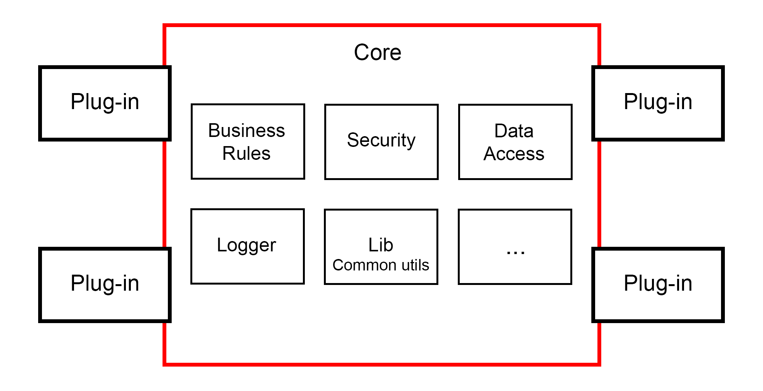
Basic scheme
itechart.com

Slide 5
History
1970s - EDT text editor
1980s - Waterloo Fortran compiler
1987 - QuarkXPress (Macintosh)
1988 - SuperPaint (Silicon Beach Software)
itechart.com

Slide 6
Extensible Application Architecture
A very important principle of Application design is the Open-Closed Principle (S.O.L.I.D).
The Open-Closed principle states that “Software entities (classes, modules, functions, etc.) should be open for extension, but closed for modification”.
It’s generally achieved by using abstractions, or by placing behavior (responsibility) in derivate classes.
A truly Extensible Software design should allow 3rd Party/External developers to extend and enhance it further even after they have been compiled and released.
This is possible only if we design our application to be easily Pluggable.
itechart.com

Slide 7
Types
External (plug-in)
Internal (module)
itechart.com

Slide 8
Strategies
Single – automatically choose one.
One of many – like Single but give the use the choice (smart phone apps).
Many simultaneously - the composite pattern, many plug-ins are treated as one (browser addons). They have the potential of overlapping.
itechart.com

Slide 9
Why/When do we need a Pluggable app?
To allow apps to be extended after they have been compiled and released.
To allow other apps to be able to connect to and enhance your app in a standard BUT isolated way.
To split work across natural boundaries.
To make Unit testing easier for teams working on different modules or plug-ins.
To deploy only new and updated features as separate plug-ins.
To design a solution which should accommodate disparate requirements implemented by other vendors in the future.
itechart.com

Slide 10
Drawbacks
Changes to contracts are difficult to manage.
Increased development time for small projects.
It's hard to detect new plugins and unload unused ones.
Validation and sandboxing.
Versioning and isolating.
Debugging, building, and compiling.
itechart.com

Slide 11
Building Extensible design in .NET
Managed Extensibility Framework (MEF) | Managed Add-In Framework (MAF)
Primarily focused on providing extensibility. | Provides extensibility along with isolation.
All the extensions are loaded in to the same AppDomain as the primary application. | All Add-ins are loaded in separate AppDomains.
Dynamic Discovery of Extensions. | Add-ins must be installed before use. No dynamic discovery.
Extensions cannot be unloaded at runtime. | Add-ins can be installed/uninstalled without affecting the primary application.
The whole app might crash, if an extension has an error. | Since the Add-ins run in their own AppDomain, they don’t affect the primary app in event of error.
Easier to implement. | Costly in terms of time, effort and complexity.
itechart.com

Slide 12
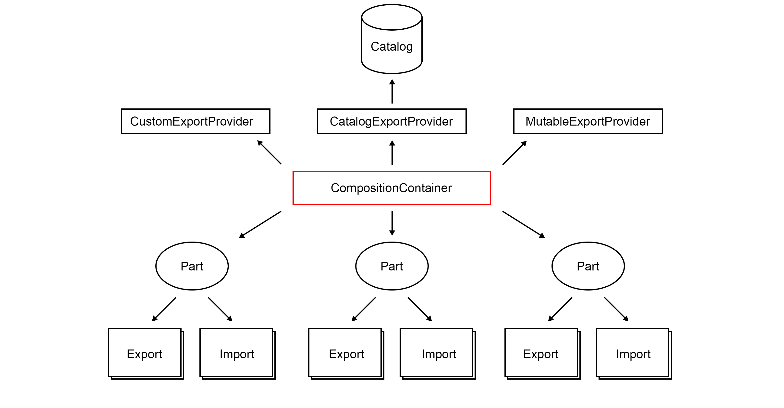
MEF Scheme
itechart.com

Slide 13
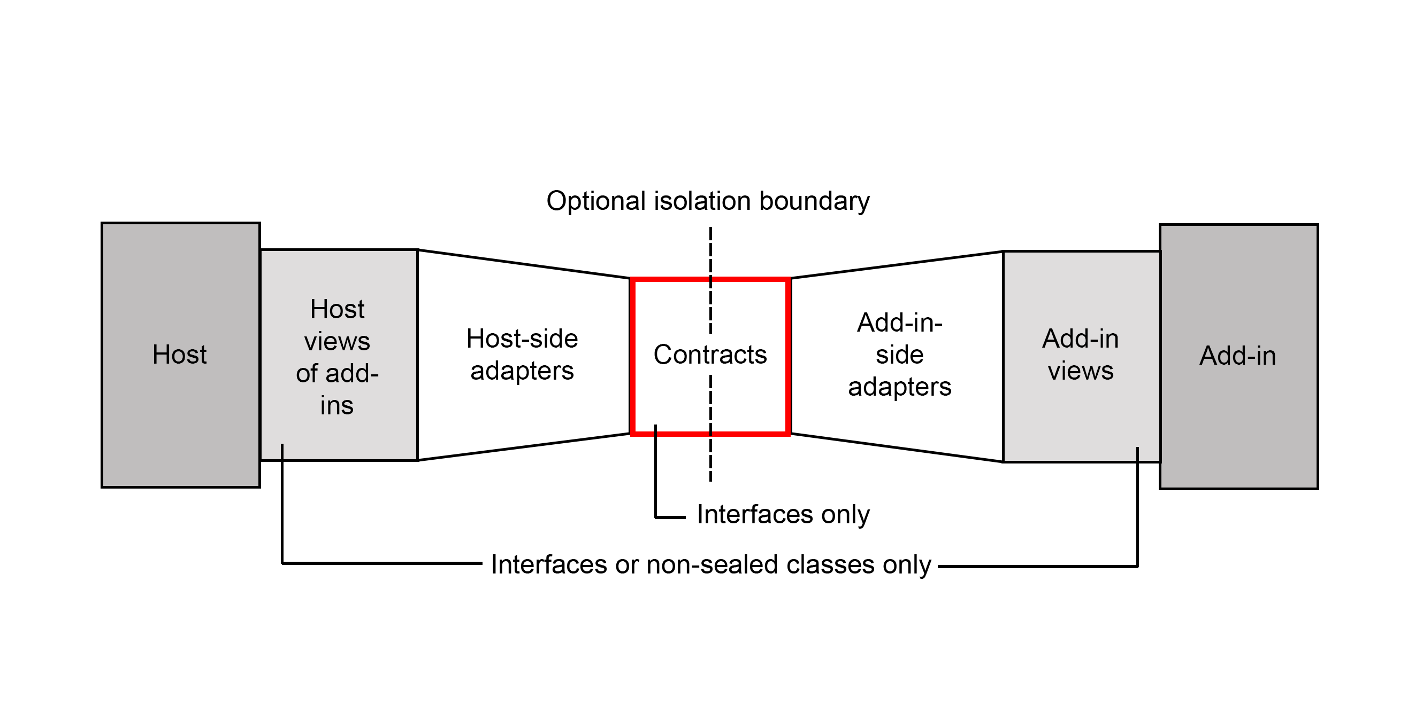
MAF Scheme
itechart.com

Slide 14
Samples
#1
#2
#3
itechart.com

Slide 15
Plug-in Architecture
itechart.com
2020

